Slide 1

June 8, 2017

Slide 2





Acknowledgements & Sponsors

Slide 3
Important Points
Emergency exits
Speakers
Feedback
https://github.com/PyDataAnnArbor
Unless quick, hold questions until the end
We’re in a borrowed space, please clean up after yourself

Slide 4
PyData Code of Conduct
http://pydata.org/code-of-conduct.html

Slide 5
Quick Icebreaker

Slide 6

This Month in Data Science
From Python to NumPy
Nicolas P. Rougier
https://www.labri.fr/perso/nrougier/from-python-to-numpy/

Slide 7
Quick Poll

Slide 8
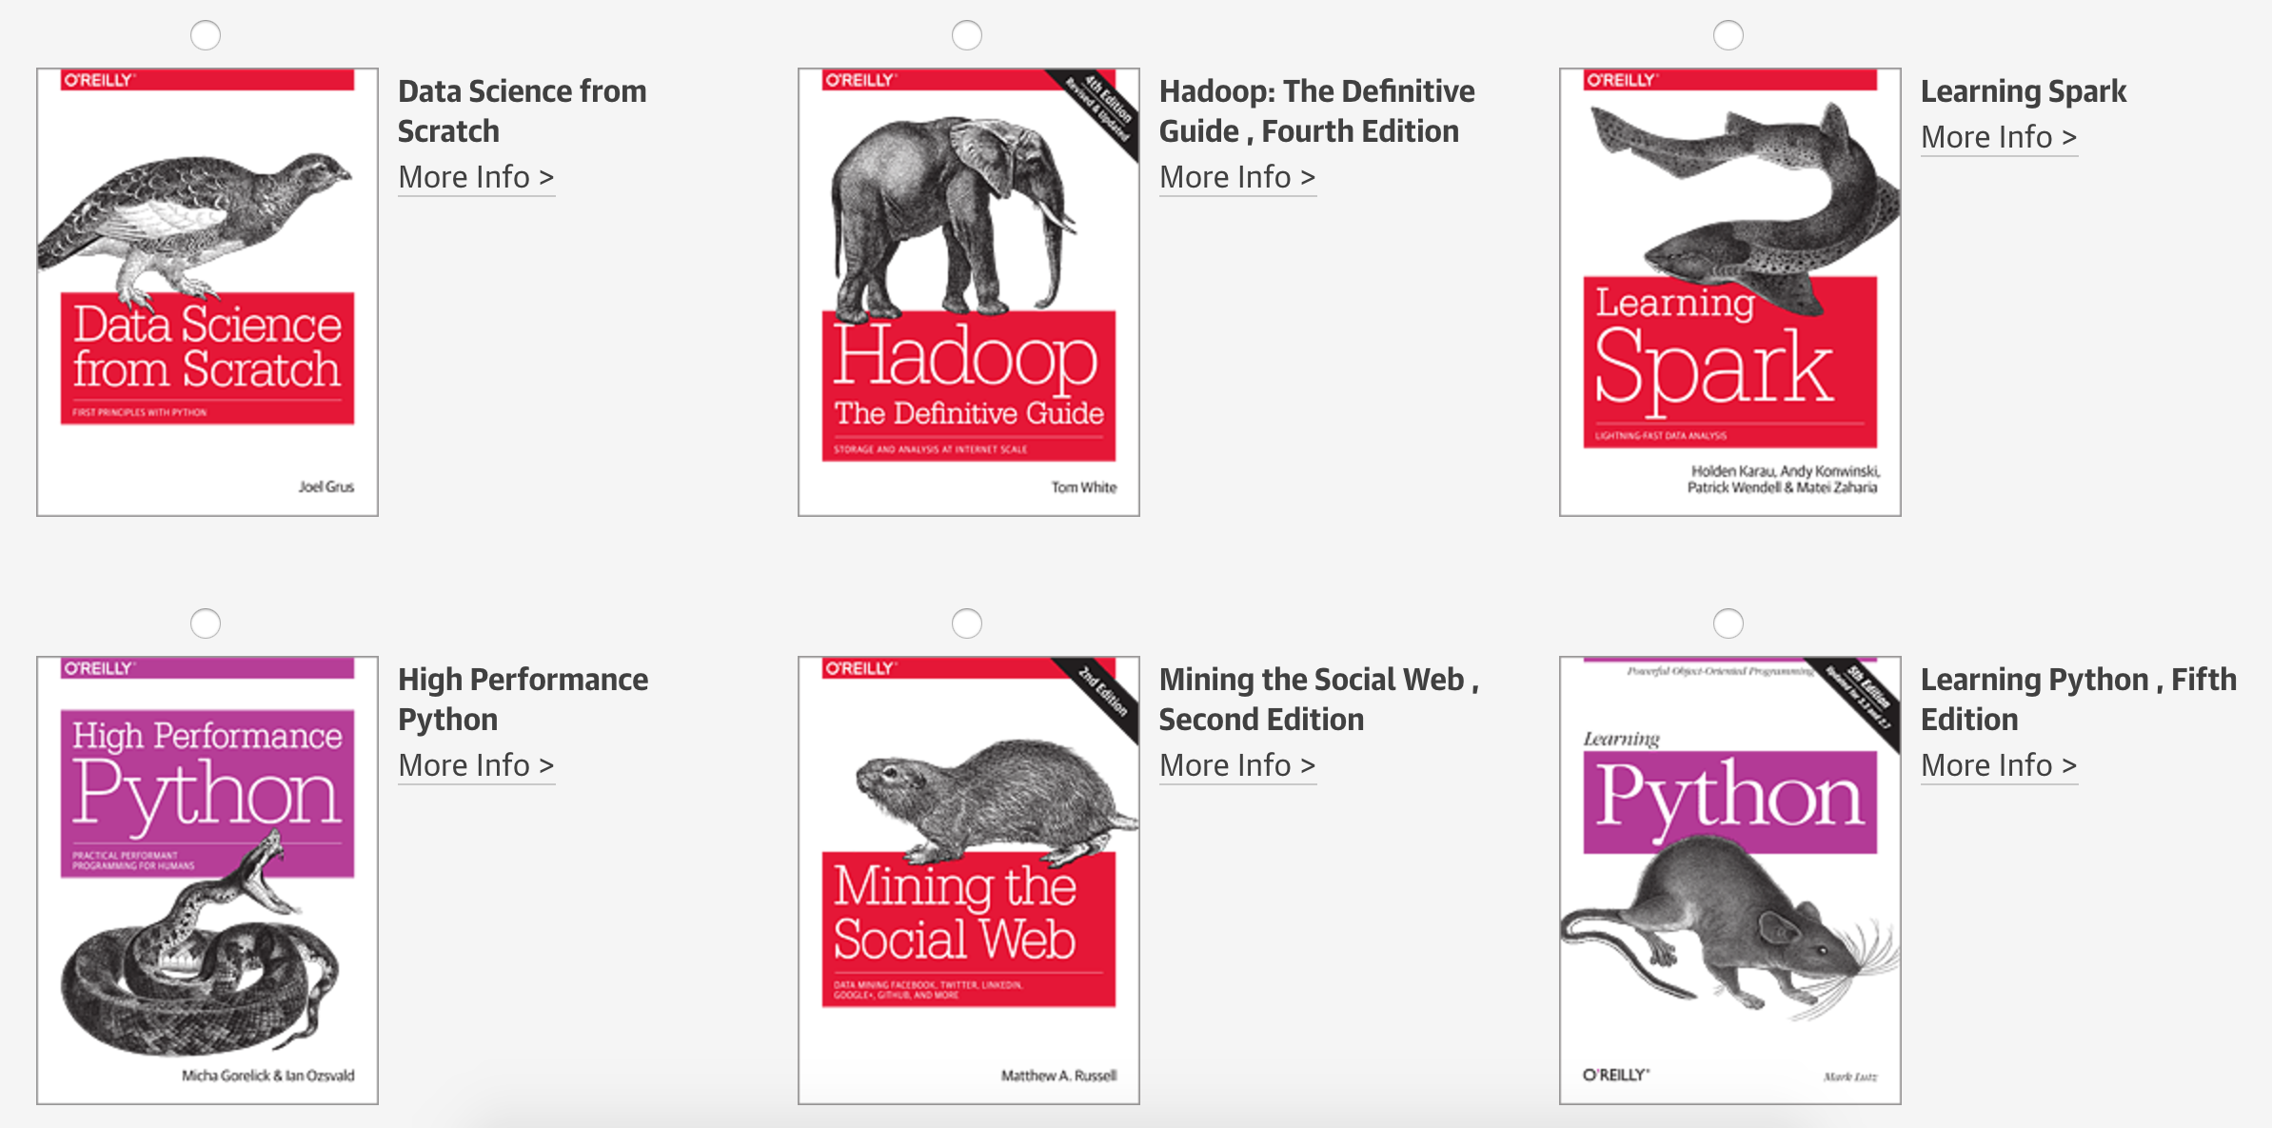
Tweet @PyDataAnnArbor

Slide 9
We’re Hiring: Sr. Data Scientist/Sr. Software Developer

Slide 10

Next Event
Who: Gus Gordon (Quantopian)
What: Designing an Algorithmic Trading Strategy in Python
When: Thursday, July 13, 2017 (6:00pm)

Slide 11
June 8, 2017

